Slide 1
Fundamentals of Data / Database Management System
Topics
Evolution of Data Storage
Database Management Systems
Architecture
Future of Data with BI etc

Slide 2
What is Data
Data is a piece of information.
All critical data needs to stored for future references
Also the data needs to be shared with different people as and when required
Data Storage Mode : Paper, Notebooks, Files(Excel, Word), Data Management Tools(SQL SERVER, MYSQL, ORACLE)

Slide 3
Evolution of Data Storage
Notebooks/
Papers
DBMS
RDBMS
ORDBMS
File Systems

Slide 4
Notebooks
Notebook/Paper is the traditional way of storing data by writing information in a notebook.
Disadvantage :
Software Application cannot connect with Notebooks
Data can be replicated or shared across multiple people easily.
File Systems
Data can be stored in a File systems like excel , word etc
Disadvantage
Data cannot be shared automatically, need to be shared through emails, shared drives etc.
Multiple people cannot access the data concurrently
Create multiple copies of the data for each users locally so single version of data cannot be maintained.
Application cannot connect directly to fetch data , need to write algorithms which is time consuming's and not standardized.

Slide 5
Database System
DATABASE MANAGEMENT SYSTEM WHICH IS USED TO STORE AND RETRIEVE DATA.
A Database Management System is a collection of programs that allows users to specify the structure of a database, to create, query and modify the data in the database and to control access to it. (e.g. limit access to the database so that only relevant staff can access details of enrolling students)
Advantage of DBMS
• It stores data in centralized server. [ e.g. : single data server]
Mail server, Banking, Reservation: centralized
o Data is being updated instantly.
o Client – Server architecture – single server – multiple clients.
o It supports disaster recovery. We can back up the data in remote locations.
o We can backup and restore the data instantly.
Security: we can give access to different users depending upon roles.
o Transactions: data can be rolled back.
Either all the tasks should be completed or it should be rolled back to the original position.

Slide 6
File System vs. DataBase
File System
Database
Data can be stored locally
Multiple versions of data as client will have its own copy.
Does not have a client – server architecture so data is stored locally.
Does not have standardized commands to connect with applications
Data can be stored in server and can be access by clients
Single version of Data using client –server architecture
Based upon client – server architecture and data is stored in the server.
Standard commands to connect from different software applications.

Slide 7
Some Popular Database Systems
Database System Available in Markets
Microsoft SQL Server
Oracle
MySQL
IBM DB2
MongoDB

Slide 8
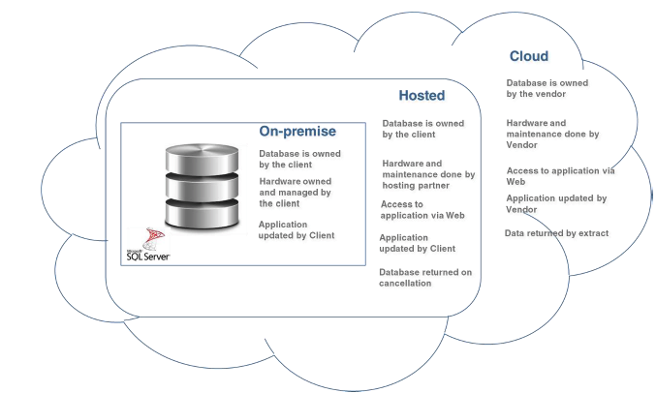
Data Server Environment

Slide 9
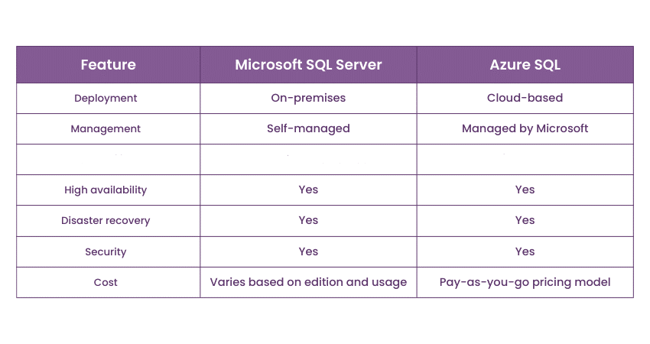
Major Differences

Slide 10
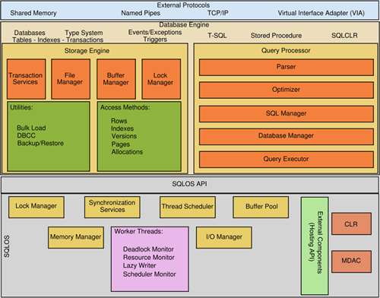
Architecture of Database System

Slide 11
If you want to…
Usage of Database System?
Create Different Software Applications
Create Cubes / Multidimensional Model
Create Mining Structures
Create Reports etc

Slide 12
Future of Database with BI and Data Mining
Application
Service
Business
Data
Relational Database
Data Warehouse
Text Warehouse
Cube
Data Integration
Text Mining
Analysis
Performance Management
Reports
Data Mining
Ad-hoc

Slide 13
Examples of Applications using Databases
Credit Risk Analysis
Churn Analysis
Customer Retention
Targeted Marketing
Market Basket Analysis
Sales Forecasting
Stock Predictions
Medical Diagnosis
Bioscience Research
Surveys
Insurance Rate Quotes
Credit Card Fraud
Web Site Events
Loan Applications
Hiring and Recruiting
Cross-Marketing
Social Science
Economics

Slide 14
Thank You

